Slide 1
Air Masses

Slide 2
Air has mass
An air mass is a body of air that is uniform in temperature, humidity and pressure.
How do we know air has mass?
Air masses are named by where they form:
Where would a cold dry air mass form?
Where would a warm and humid air mass?

Slide 3
Air Pressure in a bottle
Data Chart - draw this in your notes:
Number of pumps | Mass (g) | Mass gained/lost
0 (initial)
25
50
75
100
150
200

Slide 4
Classifying air masses
Air masses are classified based on the surface over which they form, and their overall temperature
There are 4 basic types:
Continental polar = dry and cool
Continental tropical = dry and warm/hot
Maritime polar = humid and cool
Maritime tropical = humid and warm/hot

Slide 5
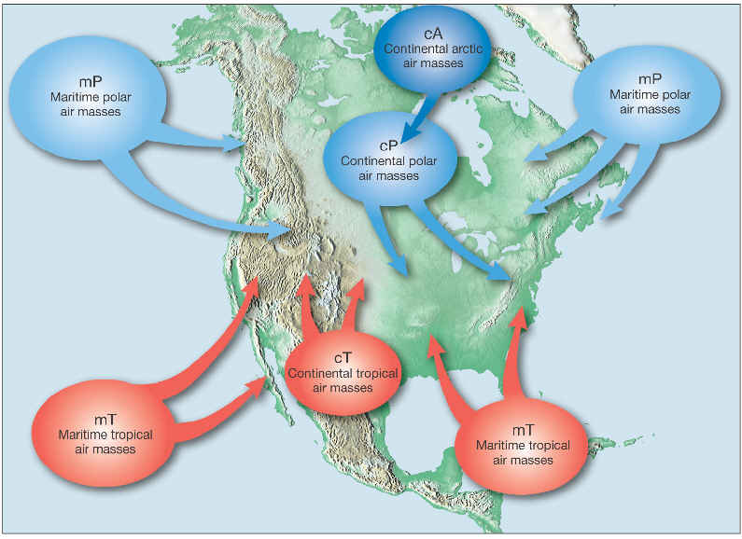

Slide 6
Modification of air masses
Air masses can modify as they travel –
Canadian frigid air mass heads to Mexico – what happens to it as it travels? What happens to the weather in the area it is traveling through?

Slide 7
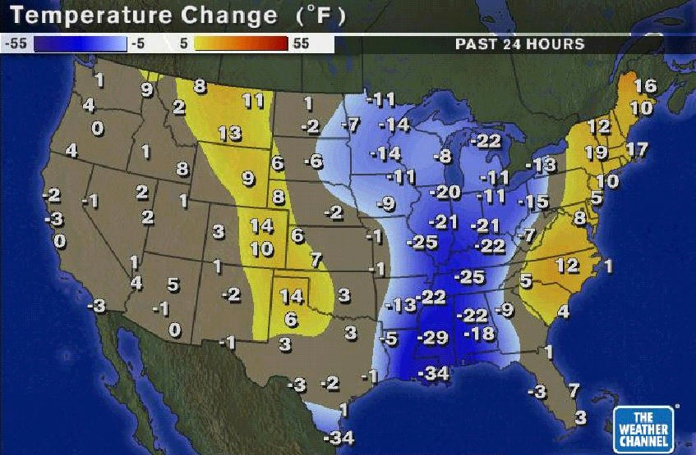
What is the result?

Slide 8
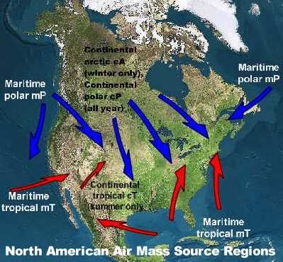
Predict what the weather map would look like in this situation.

Slide 9
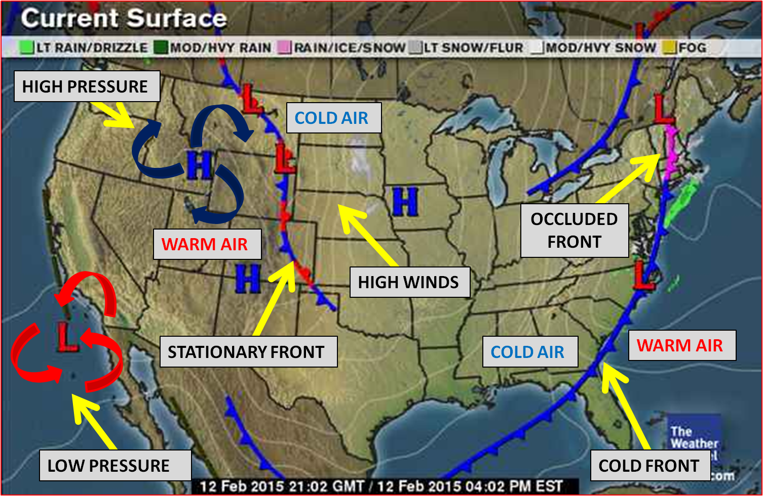
Continental polar moves south what is the weather in Montana? In Wisconsin? Georgia?

Slide 10
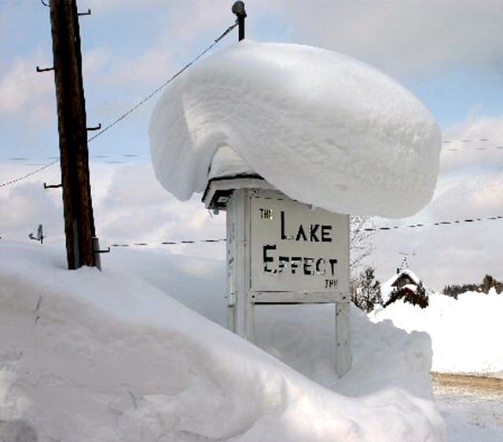
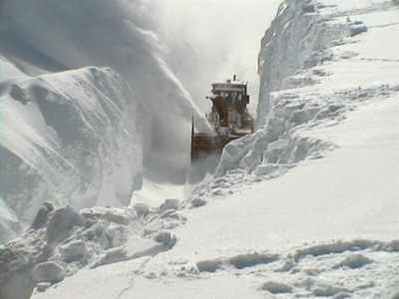
The Lake Effect
Continental polar air mass moves across the Great Lakes, and the result is _______ in Buffalo and Rochester NY.

Slide 11
Maritime tropical air masses
What kind of weather do maritime tropical air masses bring to the south eastern part of the US?
what would happen when a continental polar air mass meets a maritime tropical air mass in the winter?
something called a N’oreaster in the New England states.

Slide 12
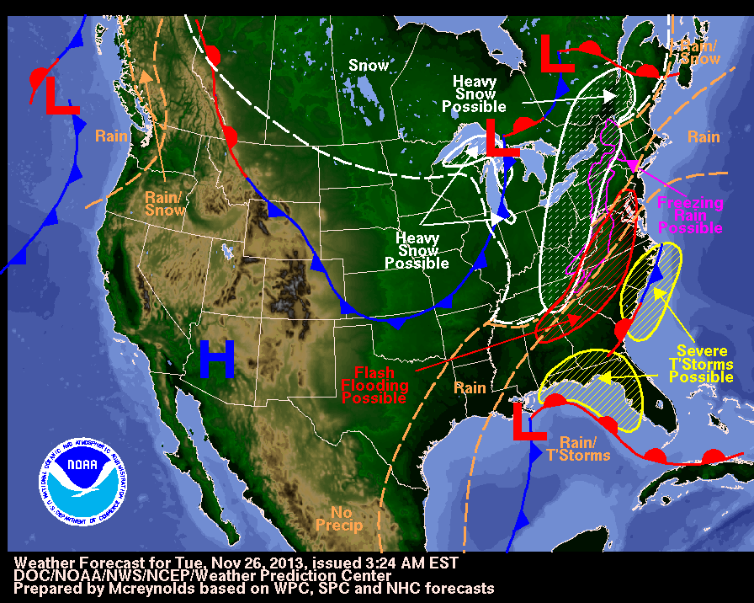

Slide 13
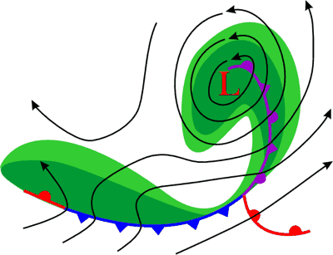
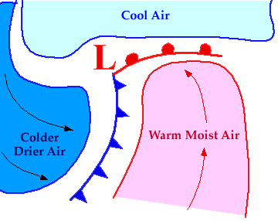
A Front is simply the boundary between air masses

Slide 14
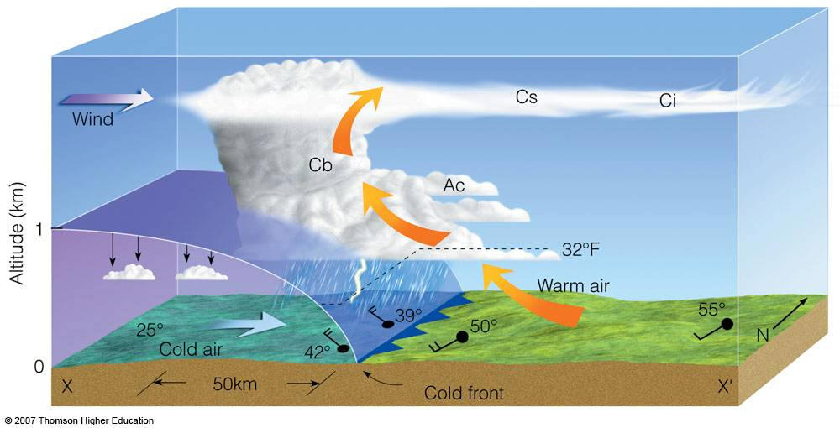

Slide 15
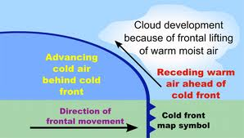
A Cold front

Slide 16
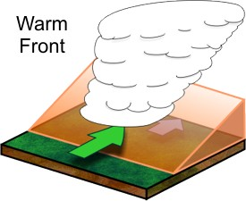

Slide 17
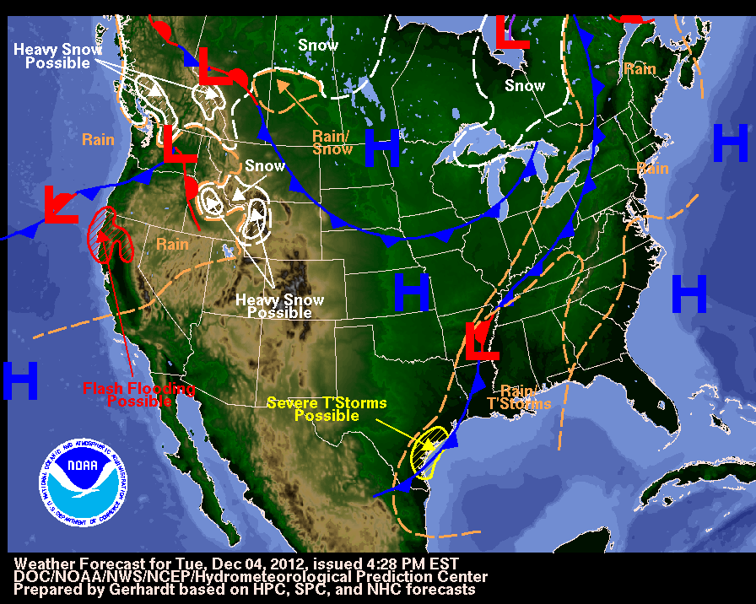

Slide 18
Please answer the following:
1. you live in Georgia – what weather would you expect to see later tonite or tomorrow?
2. write down two states that currently have cold fronts in them.
3. what two state have a low pressure centered in them? What weather are they experiencing.
4. there is snow to the north in canada, what would it take for us to have snow here in the missoula valley?

Slide 19
